Slide 1
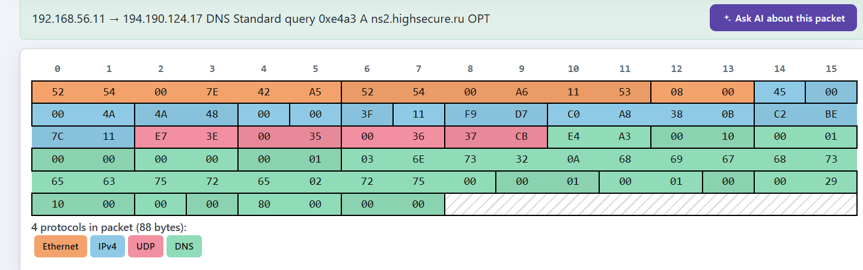
Name:Madhumitta Ch S
Reg no:1921260101
course:Computer networks
Course code:CSA0704
department:Information technology
Challenges set 1: UDP analysis
Sample to use:DNS+NTP
Open the DNS sample
Locate the UDP header
Write down the source port and destination port
What is the destination port number and which well-known service does it represent?
Source port:59198
Destination port:54

Slide 2
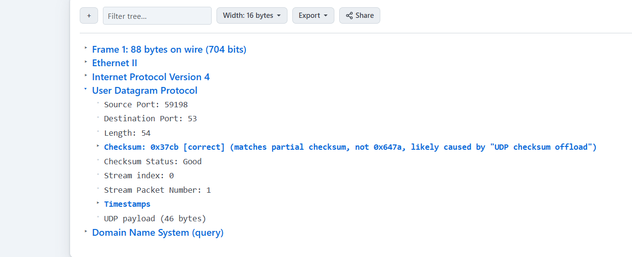
2.STILL IN THE DNS SAMPLE:
UDP length:54
UDP checksum:0x37CB
Sequence number:not present
Acknowledgement number: not present
conclusion:UDP does not use sequence numbers or acknowledgement numbers.this shows that UDP is a connectionless protocol and does not provide TCP-style reliability mechanisms.
3.open th NTP Sample:
The UDP headers of DNS and NTP contains the same four field:source port,destination port,length,checksum
The UDP Header has fixed size of 8 bytes
UDP is suitable fot both DNS & NTP because it has low overhead and provide,fast,connectionless communication.both applications can use UDP port numbers to identify the required services.

Slide 3
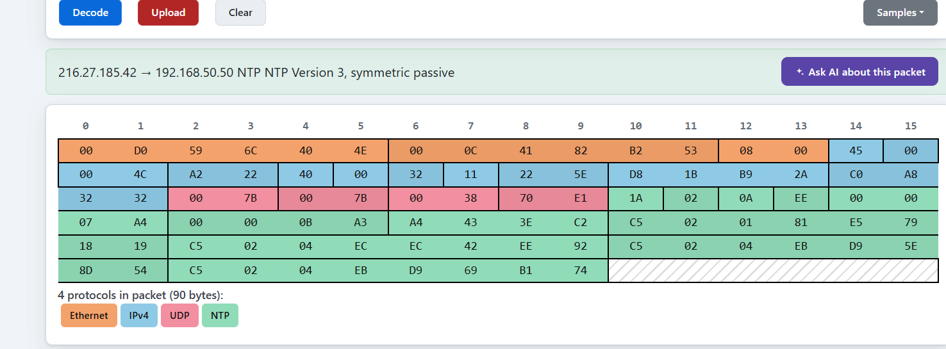
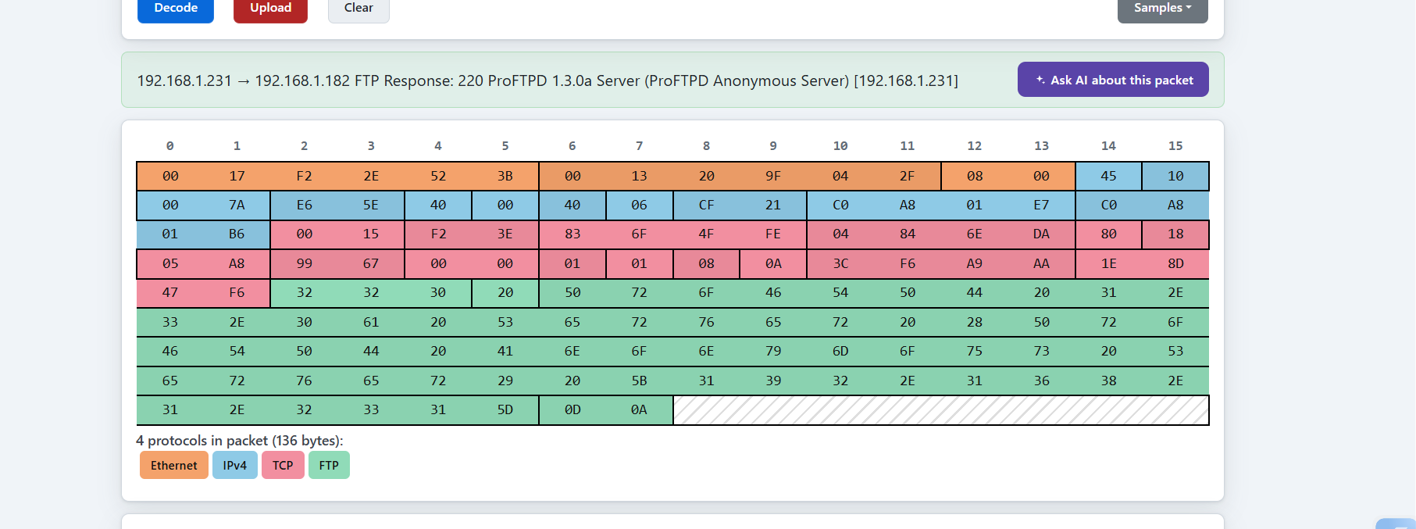
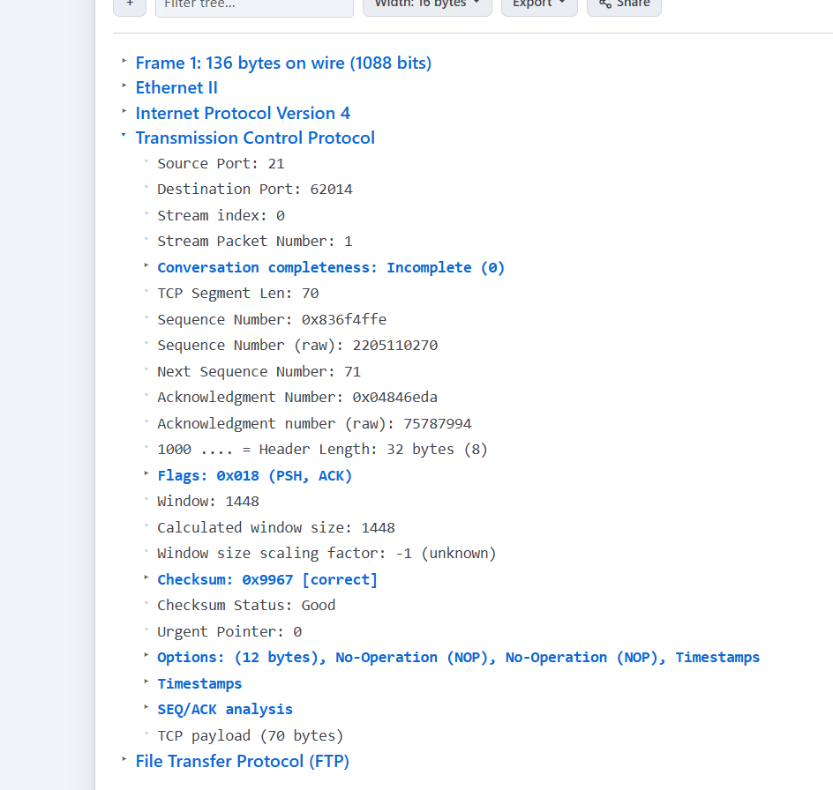
2. Challenges set 2:

Slide 4
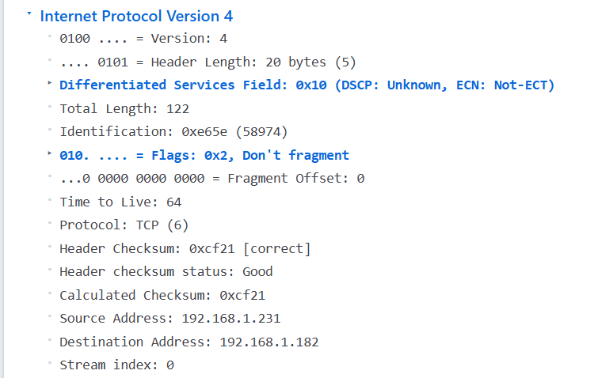
What is 4-tuple that uniquely identifies this TCP socket?
The 4-tuple is
192.168.1.231,21,192.168.1.182,62014
The tuple consists of the source IP address,source port,destination IP address,and destination port. It uniquely identifies a TCP connection and helps the operating system perform demultiplexing by delivering each incoming packet to the correct TCP socket/application

Slide 5
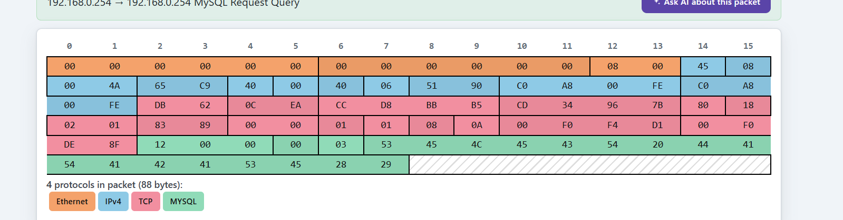
6. Open mysql sample:
FTP destination:662014
MYsql destination:3306
The destination ports are different.
The operating systems uses the IP address and port numbers of each TCP connection to perform demultiplexing.this allows it to allows to identify the correct and socket and deliver each packet to the appropriate application.

Slide 6
Challenges set 3:TCP vs UDP comparison
TCP has a larger header than UDP. The minimum TCP header size is 20 bytes, while the UDP header is 8 bytes.
TCP provides reliability features such as sequence numbers, acknowledgement numbers, flags, and window size. UDP does not provide sequence numbers or acknowledgement numbers
. TCP is connection-oriented, while UDP is connectionless. The FTP sample shows TCP sequence and acknowledgement numbers, whereas the DNS sample using UDP does not contain these fields.
8. From the FTP sample: o Point out any fields that show TCP’s duty of providing reliability and flow control.
The FTP TCP header contains several fields that provide reliability and flow control:
• Sequence Number: 0x836F4FFE — helps maintain the correct order of data.
• Acknowledgement Number: 0x04846EDA — acknowledges received data.
• ACK Flag: Set — indicates that acknowledgement information is presen
t. • Window Size: 1448 — provides flow control by indicating the amount of data the receiver can accept
.

Slide 7
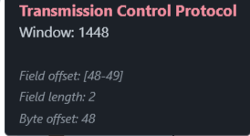
Therefore, Sequence Number and Acknowledgement Number support reliability, while Window Size provides flow control.
Challenges set 4: modern transport
Sample to use:QUIC
Underlying Transport Protocol:
UDP Destination Port:443
QUIC runs over UDP but provides its own transport features, including reliability and connection management. Unlike classic TCP, QUIC does not use the TCP protocol and header; it uses UDP as its underlying transport.

Slide 8
